Slide 1
Quantum Computing:
Hardware

Slide 2
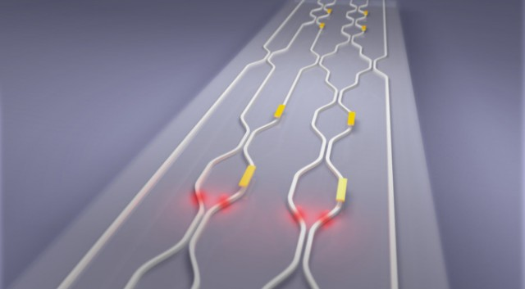
Photonic Quantum Computing
1 Qubit Gates
2 Qubit Gates
Photons

Slide 3
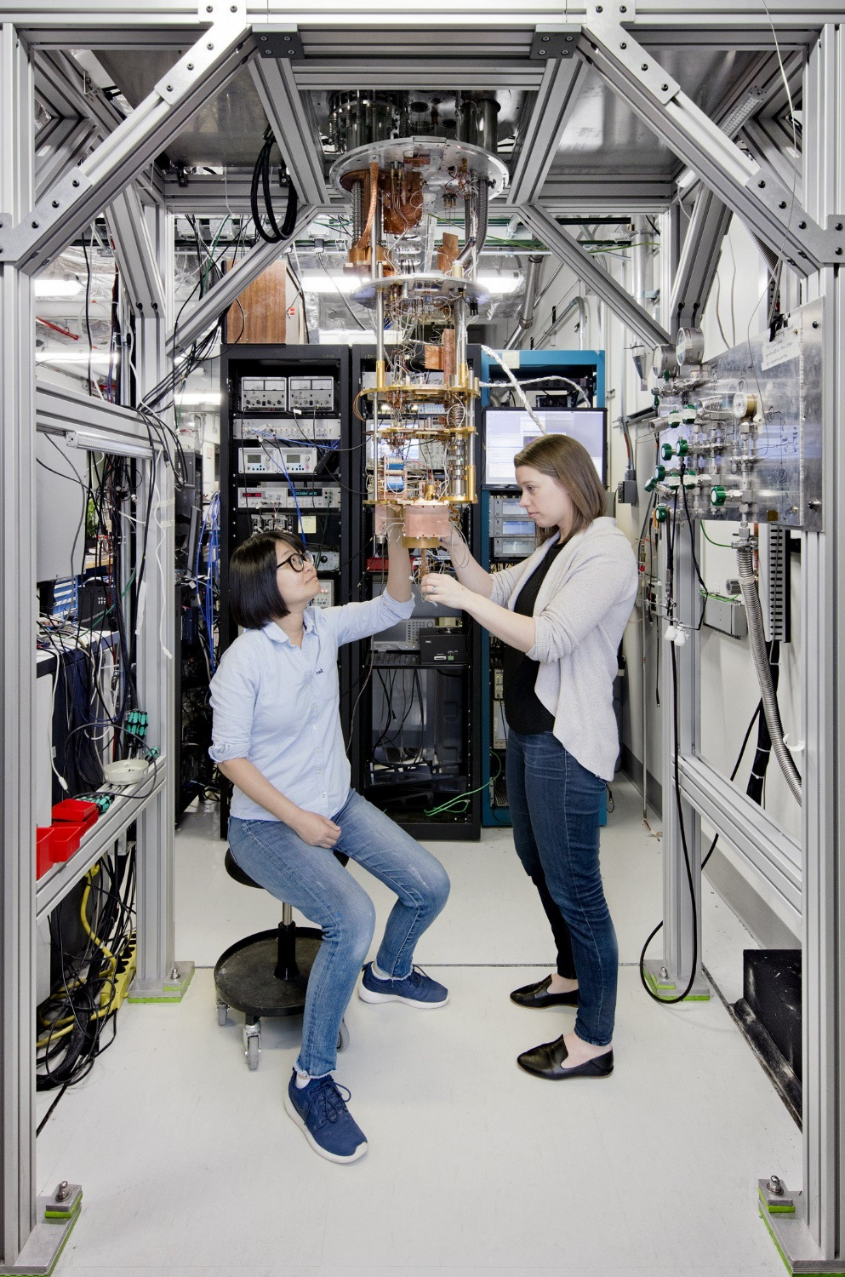
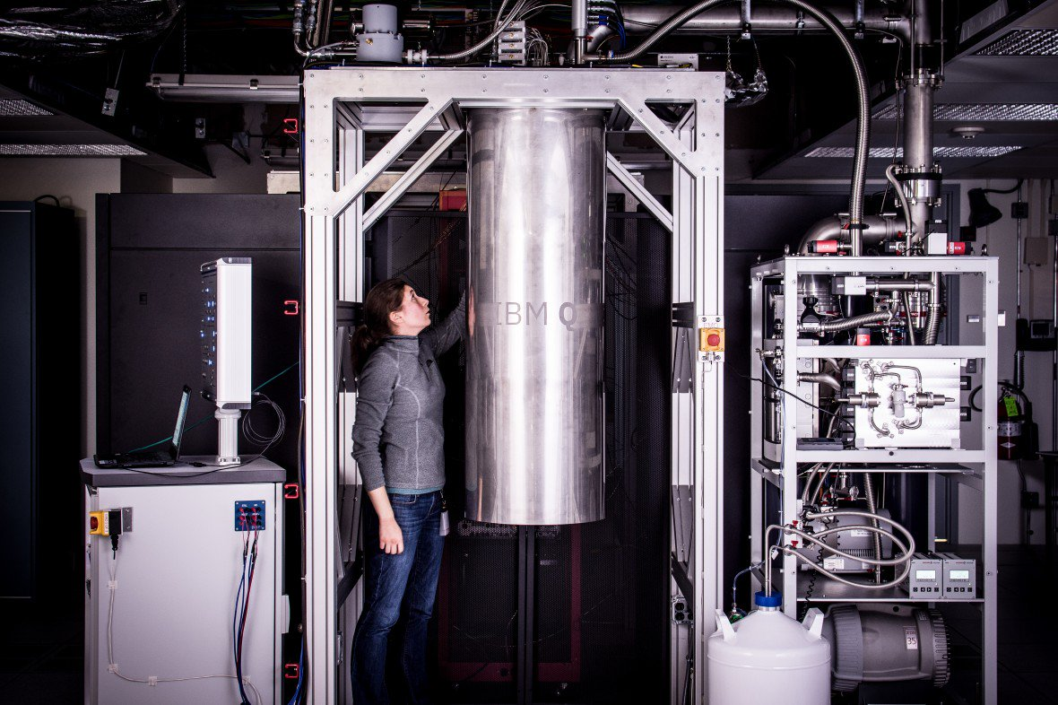
Superconducting Qubits: IBM
Dilution Refrigerator (T < 1 K inside)
Photo Credit: MIT Tech Review

Slide 4
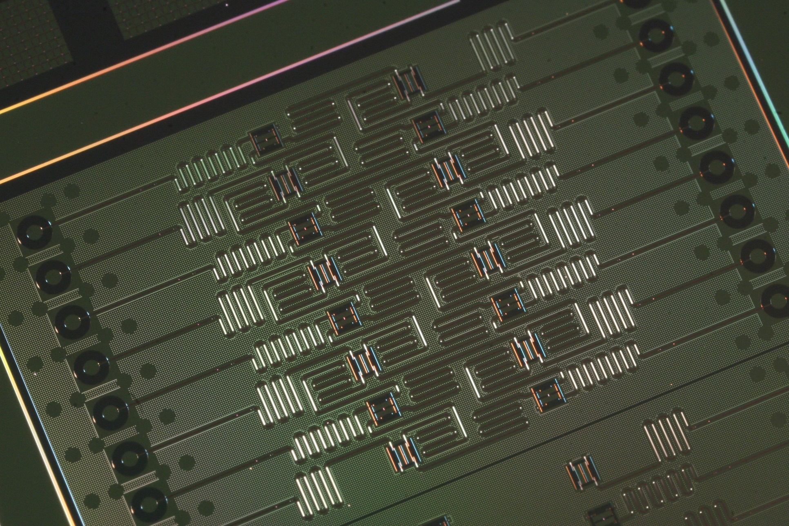
Superconducting Qubits: IBM
Qubit Connection Wires
Qubits
Control Wires
Photo Credit: MIT Tech Review

Slide 5
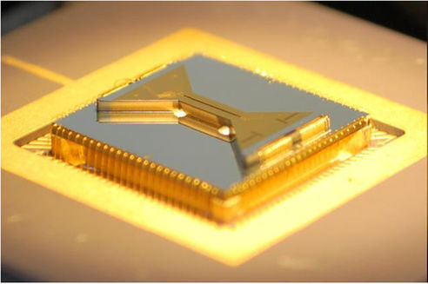
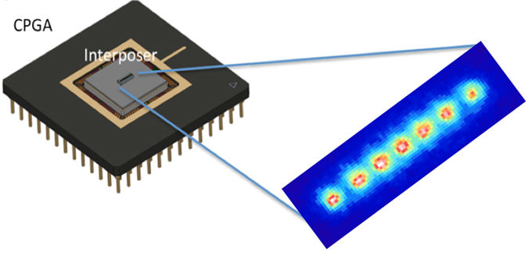
Ion Trap Hardware
Levitated Ion String
“High Optical Access”: HOA 2 Trap
Sandia National Labs

Slide 6
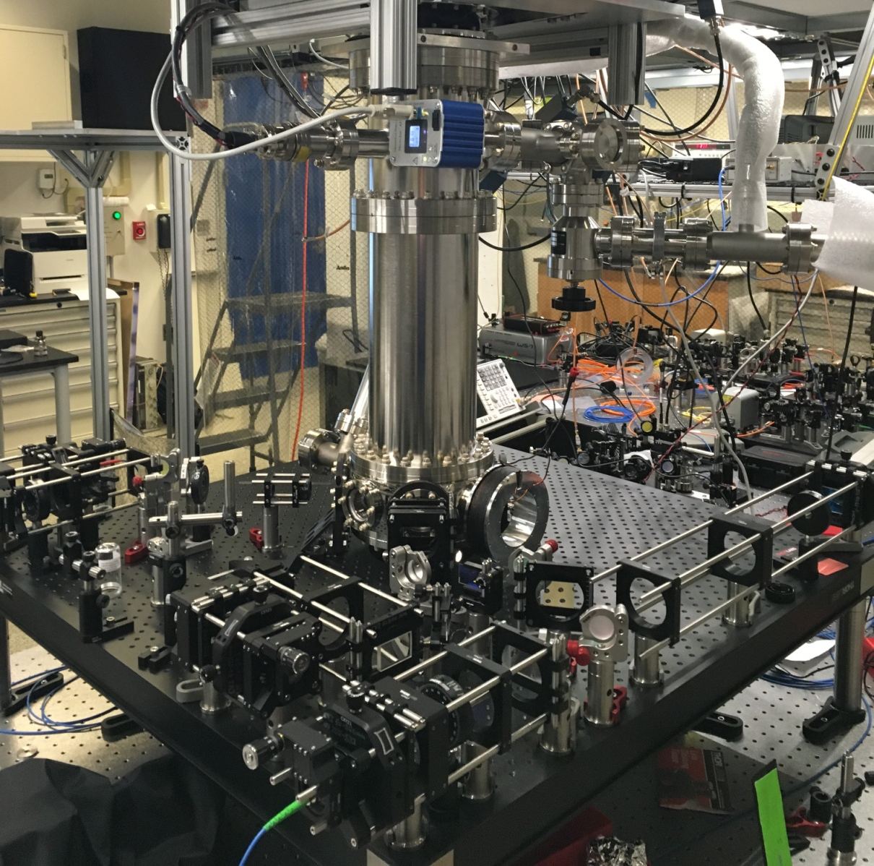
Ion Trap Hardware
Ultrahigh-Vacuum Chamber
Windows
Optics for delivering laser light

Slide 7
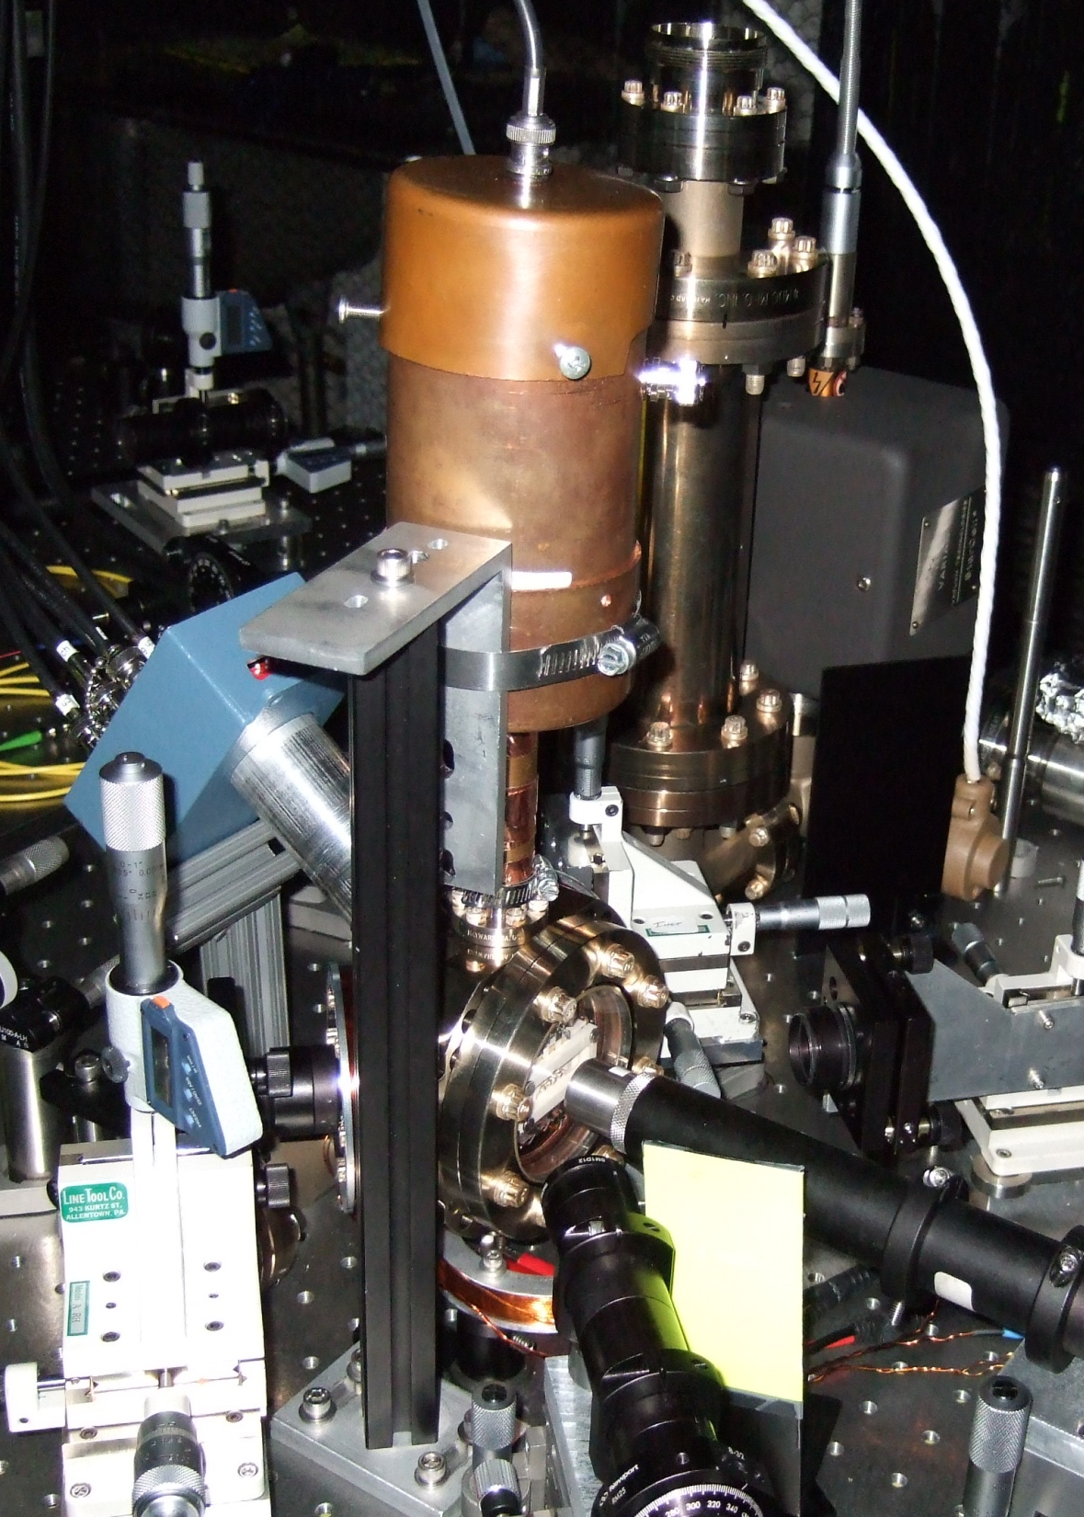
Ingredients for an RF Ion Trap
Radio Frequency Amplifier
Ultra-high vacuum pump
Ion Trap Electrodes
Vacuum chamber with window ports
Microscope Objective
Laser Delivery Optics
+ 4 Laser Systems (Not Shown)
Notes:
UHV is better than the vacuum you would feel on the moon.

Slide 8
Loading and Cooling Ions
+
Neutral Atom Oven
Photoionization Laser

Slide 9
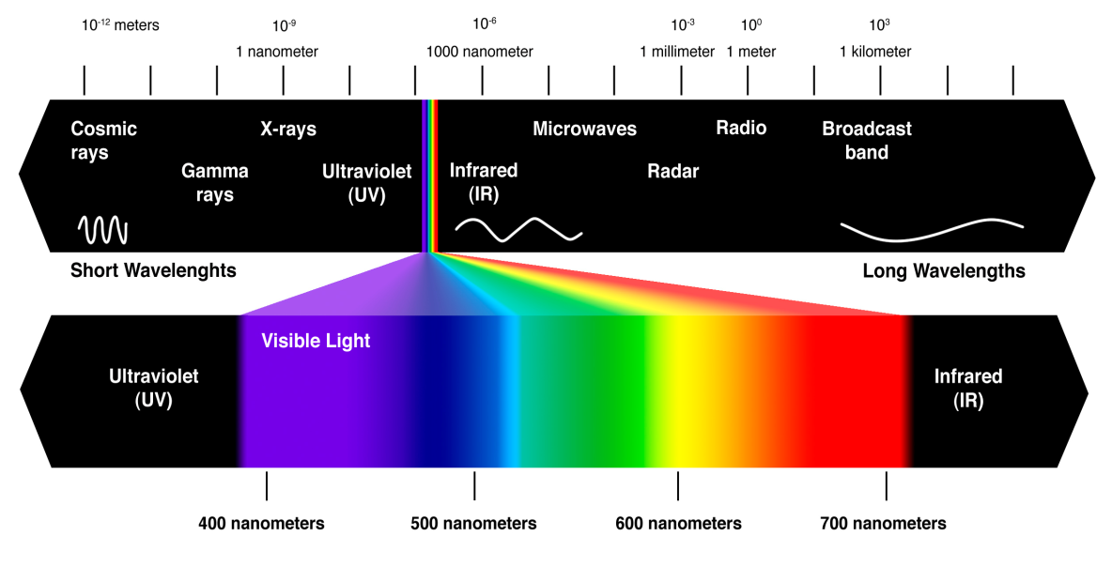
Loading and Cooling Ions
+
Neutral Atom Oven
Doppler Cooling Laser
369 nm
Repump Laser
Photoionization Laser
935 nm
399 nm
Laser colors for Ytterbium (Yb)

Slide 10
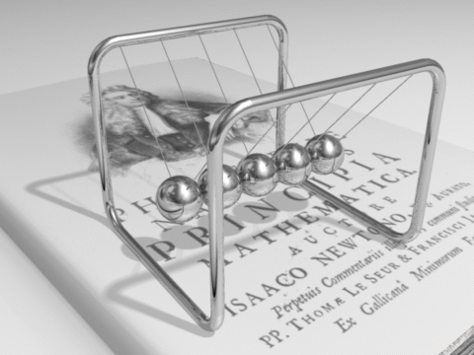


Linear Chains of Ions
+
+
+
+
+
Trapped Ion Motional Modes
Center of Mass
$$ω_{com}=ω_{a}$$
Newton’s Cradle
Artist’s Rendition of a Trapped Ion Quantum Computer
Breathing
$$ω_{brth}={\sqrt{3} ω}_{a}$$
Photo Credit: Scientific American

Slide 11
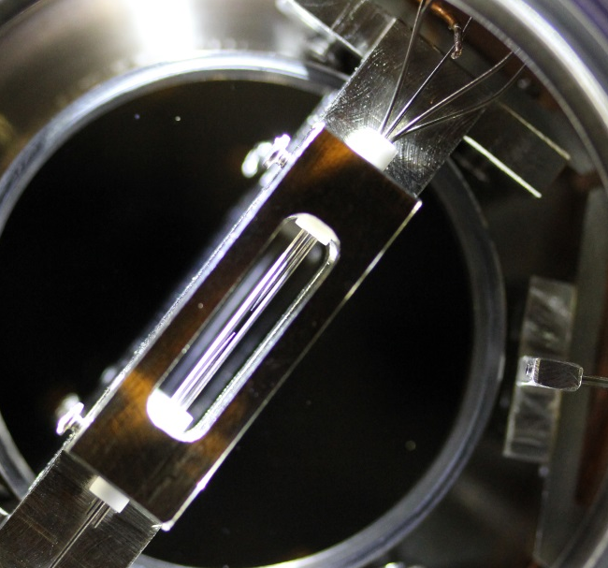
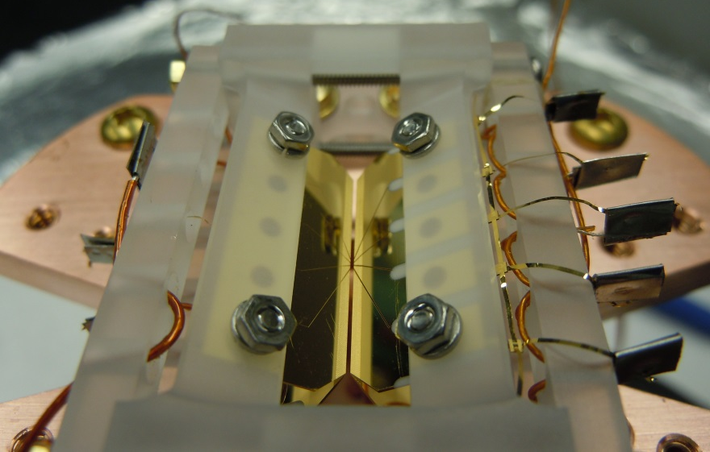
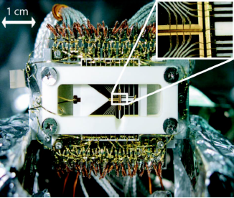
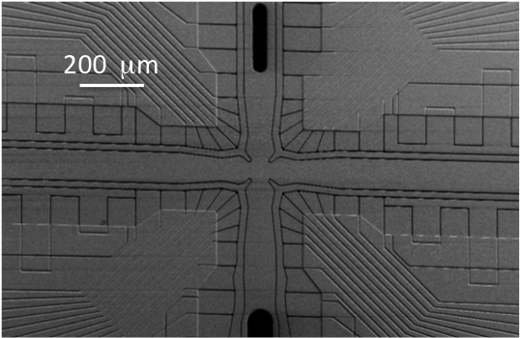
Types of Ion Traps
Yb oven
“Blade” Trap
“Four Rod” Trap
“Surface” Trap
“T-Junction 3-Layer” Trap
- GTRI QS group

Slide 12
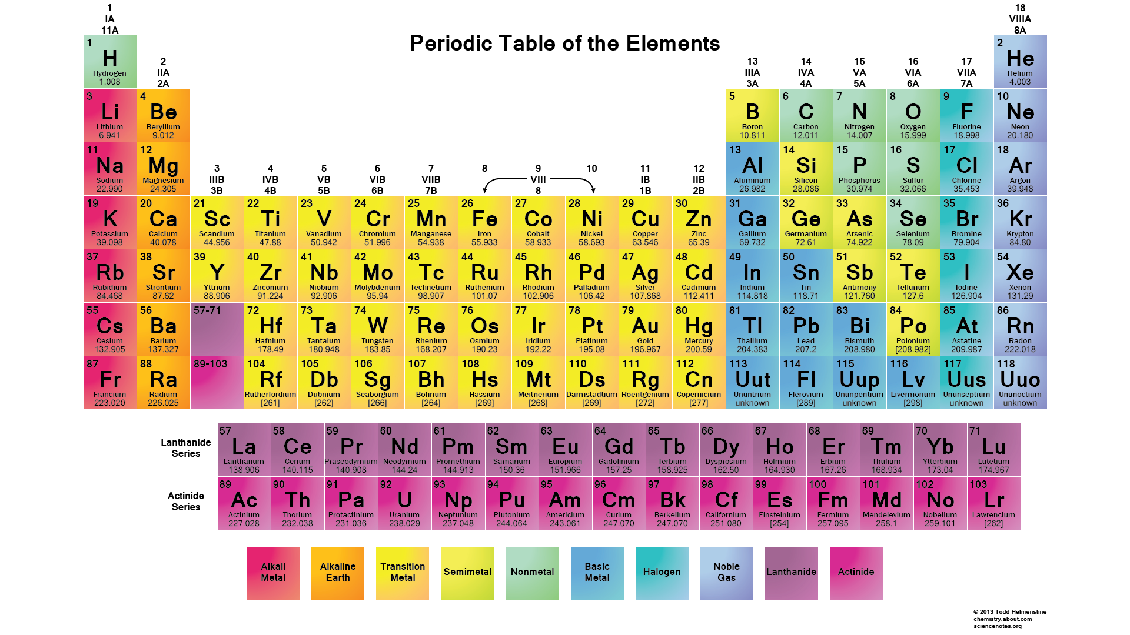
Choosing an Ion
Hydrogen-like when you remove one electron
When picking an atom to trap, consider:
Mass
Resonant Wavelengths (Spectrum)
Can you make it into a qubit?

Slide 13
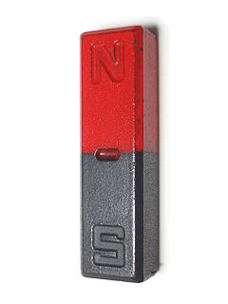
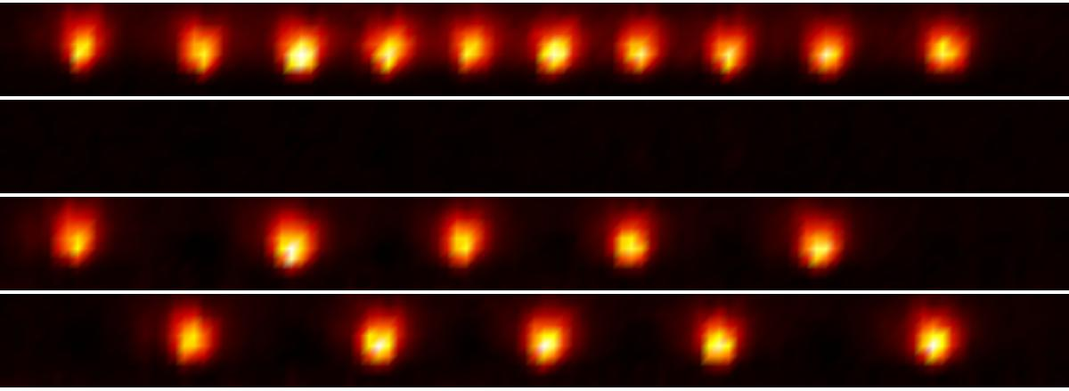





Atomic Qubits
Electron
$$|1⟩$$
$$\left|↑\right\rangle$$
or
Microwave
Frequencies
Nucleus
$$|0⟩$$
or
$$\left|↓\right\rangle$$
“Computational Bits”
“Spins”
“The Hyperfine Interaction”
Interacting Bar Magnets
A trapped ion quantum state measurement
$$| 0 1 0 1 0 1 0 1 0 1 ⟩$$
Notes:
12.7 GHz is a satellite communication band.

Slide 14

Generating Entanglement
355 nm,
Pulsed Laser
Ion Energy
Spin-Dependent Force
+
+
or
$$\hat{F}=F_{↑}\left|↑\right\rangle \left\langle ↑\right|−F_{↓}\left|↓\right\rangle \left\langle ↓\right|$$
+
+
Increasing Energy
Push if
+
or
+
Pull if
+
+

Slide 15
Controlling Trapped Ion Qubits
Microwave Horn
355 nm,
Pulsed Laser
Rotate All Qubits
Entangle All Qubits
+
+
+
+
+
+
+
+

Slide 16
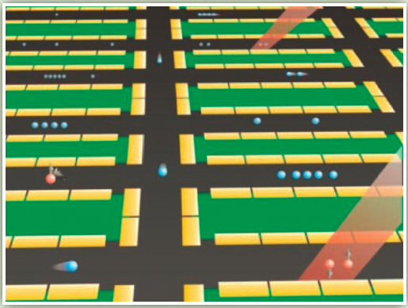
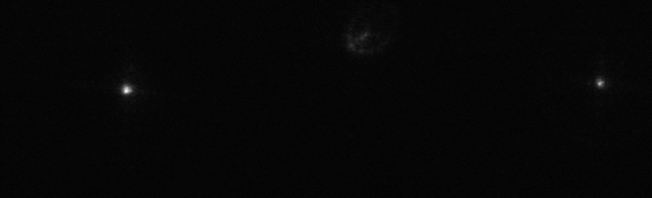
A Moveable Qubit
“Quantum CCD” Ion QI Processor
Shuttling in a surface trap
- GTRI QS group
- NIST Ion Storage group

Slide 17
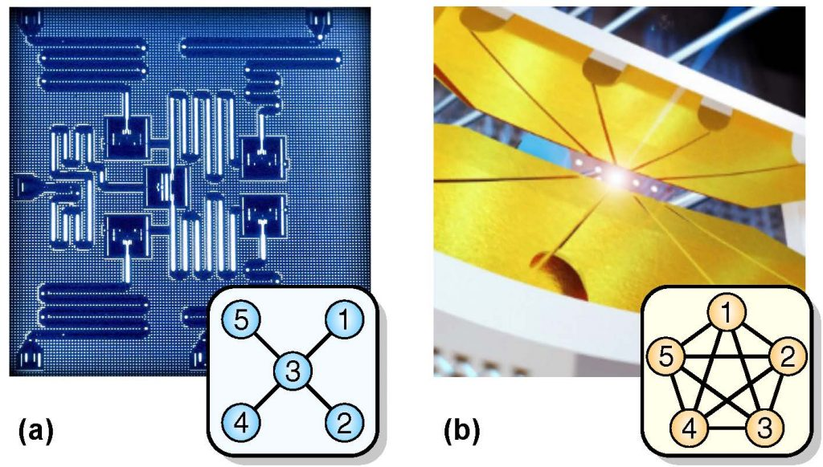
Wiring Matters:
Superconductors vs. Trapped Ions
Experimental Comparison of Two Quantum Computing Architectures,” N. M. Linke, et. al. Proceedings of the National Academies of Science 114, 13 (2017).

